Slide 1
UML Modeling: System Sequence Diagram
Instructor: Mehroze Khan

Slide 2
Revision Up till Now
Set of Requirements
Use Case Diagram
High-Level and Expanded Use cases
Main Success Scenarios
System Sequence Diagram
Domain Model
Use case Identification
Non- Functional Requirements
Functional Requirements
Boss test
Elementary Business Process
Size Test
Represent feature/functions/user goals

Slide 3
System Behavior
System Behavior describes what a system does, without explaining how it does it.
Before making a logical design of how the software system should work, we need to investigate and define its behavior as “Black box”.
System Sequence Diagrams (SSD)

Slide 4
System Sequence Diagrams
Focuses on the interaction between the system and external actors (e.g., users, other systems).
Provides a high-level view, showing system-level interactions without detailing internal logic or class interactions.
Emphasizes what happens from a user’s perspective, capturing events triggered by external actors.

Slide 5
System Sequence Diagrams
System sequence diagram (SSD) are used to illustrate interaction between actor and system for a particular scenario of a use case.
A system sequence diagram is a picture that shows, main success scenario, the events that actors generate, their order and inter-system events
The purpose is to illustrate the use case in a visual format and identify all system events
SSD are drawn using UML notations
We draw SSD using Sequence Diagram notation (UML)

Slide 6
Recall – Use Cases
Use cases describe how actors interact with the software system and during this interaction
an actor generates events to a system
usually requesting some system operation to handle the event
SSD show how certain tasks are done between actors and the system (use case scenarios).
The tasks could be simple, complex or repetitive tasks.

Slide 7
Creating System Sequence Diagrams
Should be done for the typical course of events/main success scenario of the use case (and for the most interesting alternative course).
A single system sequence diagram shows the interaction between an actor and the system for one use case scenario.
It shows:
The system (as a black box)
The actor(s), especially the initiating actor
Each external system which sends messages to the system
The messages into and out of the system
The sequence in which the messages occur

Slide 8
System Events and System Operations
System operations are the operations that the system as a black box component oﬀers in its public interface.
These are high-level operations triggered by an event generated by an external actor
During system behavior analysis, system operations are assigned to a conceptual class System

Slide 9
Creating System Sequence Diagrams
Should be done for the typical course of events/main success scenario of the use case (and for the most interesting alternative course).
Draw a line representing the system as a black box.
Identify each actor and draw a line for each such actor.
From the use case typical course of events text, identify the system (external) events that each actor generates.
Illustrate them on the diagram.
Optionally, includes the use case text to the left of the diagram.

Slide 10
Actor Lifelines
User: Represents a person interacting with the system (e.g., customer, admin, employee).
External System: Represents other systems that interact with the main system (e.g., payment gateways, third-party services, databases).
Sensor/Device: Represents hardware devices or sensors that interact with the system (e.g., RFID reader, IoT devices).

Slide 11
System Lifeline
System: Represents the entire system as a single lifeline (e.g., "Banking System," "Inventory Management System").
This lifeline does not represent individual classes or objects within the system; rather, it encapsulates the system as a whole.

Slide 12
Syntax of SSD

Slide 13

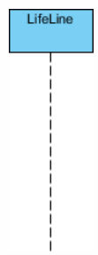
Sequence Diagram Notations
Lifelines: Represents an actor or the system, depicted as a vertical dashed line starting from a rectangle (head).
Actor Lifeline: Stick figure with the actor’s name (e.g., Customer).
System Lifeline: Box labeled with the system’s name (e.g., Online Shopping System).

Slide 14
Sequence Diagram Notations
Activation Boxes: Rectangles placed on the lifeline, representing the period during which an object is active and processing a message.
Usage in SSDs: Rarely used, since SSDs focus on external interactions rather than internal processing.

Slide 15
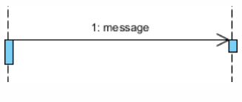
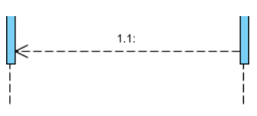
Sequence Diagram Notations
Call Message: Horizontal arrows connecting lifelines, showing the flow of messages or interactions between the actor and the system.
Arrows: Solid lines with arrowheads pointing from the sender to the receiver.
Message Label: Text above or below the arrow, describing the interaction (e.g., placeOrder(), login(), confirmPayment()).
Return/Reply Message:
Syntax: Dashed arrows with arrowheads, pointing back to the sender.
Shows responses or results from the system to the actor (e.g., orderConfirmed, paymentSuccess).
Notes:
A call message is a request or command sent from one participant (like an actor or another system) to another participant to perform an action or provide information.
When to Use:
When an actor initiates an action (e.g., a user clicking a button).
When one system sends a request to another system or component (e.g., a mobile app requesting data from a server).
To indicate the start of a process, such as a user entering information or selecting an option.
A reply message is a response from a participant to a previous call message, indicating the outcome of that call.
When to Use:
When a system responds to a request made by an actor or another system (e.g., returning data, confirmation of an action).
To indicate the result of a processing operation after a call message has been made.
When showing that an action has been completed, especially when feedback is being provided to the user.

Slide 16
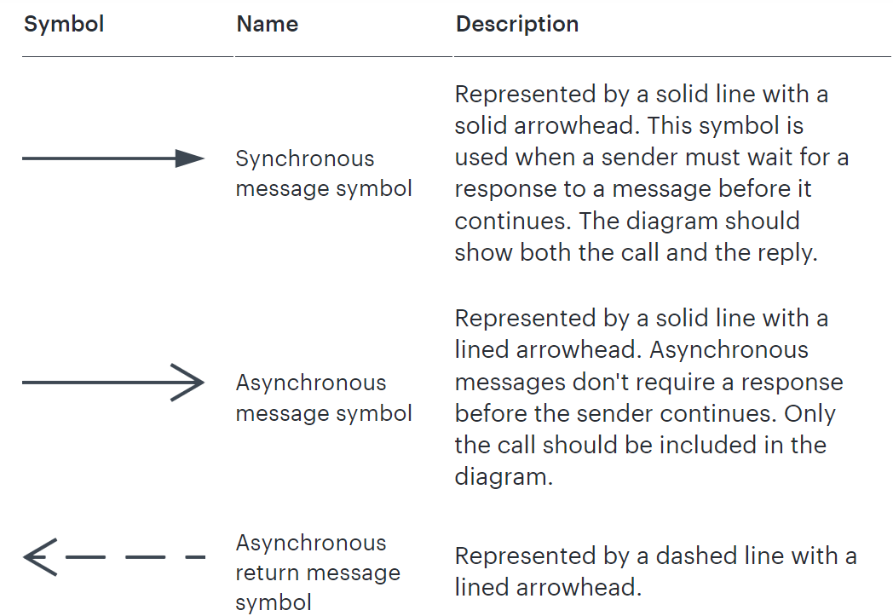
Blocking
Non-Blocking
Notes:
Synchronous Message:
Activation Box: Often, the receiver’s lifeline has an activation box (a thin rectangle) showing that the receiver is processing the message.
Return Message: A dashed line with an open arrowhead going back to the sender represents the response.
Asynchronous Message:
Arrow Type: A solid line with an open arrowhead (unfilled) pointing from the sender to the receiver.
No Waiting: No return message is mandatory because the sender does not pause its execution. In System Sequence Diagrams (SSDs), the focus is primarily on capturing high-level interactions between external actors (like users or other systems) and the system itself. Typically, SSDs use synchronous messages because they represent operations where the system immediately responds to the external actor’s request, showing a clear cause-and-effect relationship.

Slide 17
System Sequence Diagram Notation
:
.
Note that software participants cannot perform operations on human actors!
Notes:
In SSDs, the system is often shown with just the class type since it represents the whole system rather than a specific object:
:OnlineShoppingSystem
For Design Sequence Diagram:
Syntax: objectName : ClassName
objectName (optional): The specific instance or object of the class.
ClassName: The class or type of the object.
Example: orderProcessor : OrderHandler

Slide 18
Process Sale

Slide 19
Recall the Process Sale Use case
Actor Action | System Response
1. The use case begins when Customer arrives at the POS checkout with items to purchase. Cashier Starts a new Sale.
2. Cashier records each item identifier. If there is more than one item, Cashier can enter the quantity as well. | 3. Determines the Line item price and adds the Line item information to the running sales transaction. The description and price of the the current item are presented.
4. Cashier repeats 3 – 4 for all items. On completion of item entry, the Cashier indicates to the POS that item entry is complete and sale has ended. | 5. Calculates and presents the sale total with taxes.
6. The Cashier tells the Customer the total and asks for payment.
7. Customer makes payment by cash | 8. System logs completed sale 9. Provides receipt

Slide 20
How to construct an SSD from a use case?
Draw System as black box on right side
For each actor that directly operates on the System, draw a stick figure and a lifeline.
For each System events that each actor generates in use case, draw a message.

Slide 21
System Events
System event is an external input event generated by an actor (may include parameters).

Slide 22


System Sequence Diagrams
Naming: wording should be consistent with the domain
:System
Cashier
better name
enterItem(itemID, quantity)
scan(itemID, quantity)
worse name
enterItem is what is done;
scan serves the purpose of entering an item
and is system related (bad)

Slide 23
Naming System events & operations
System events and associated system operations should be expressed at the level of intent
Use verbs from use case or make, start, enter, end etc.. rather than physical input medium or UI widget
Notes:
Vereb phrase similar to process name (of DFD).

Slide 24
Recall the Process Sale Use case
Actor Action | System Response
1. The use case begins when Customer arrives at the POS checkout with items to purchase. Cashier Starts a new Sale.
2. Cashier records each item identifier. If there is more than one item, Cashier can enter the quantity as well. | 3. Determines the Line item price and adds the Line item information to the running sales transaction. The description and price of the the current item are presented.
4. Cashier repeats 3 – 4 for all items. On completion of item entry, the Cashier indicates to the POS that item entry is complete and sale has ended. | 5. Calculates and presents the sale total with taxes.
6. The Cashier tells the Customer the total and asks for payment.
7. Customer makes payment by cash | 8. System logs completed sale 9. Provides receipt

Slide 25
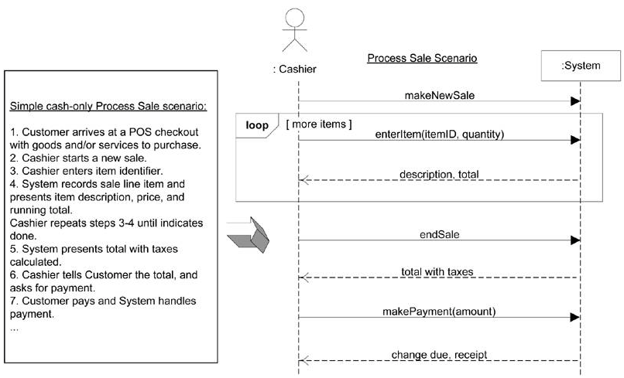

Slide 26
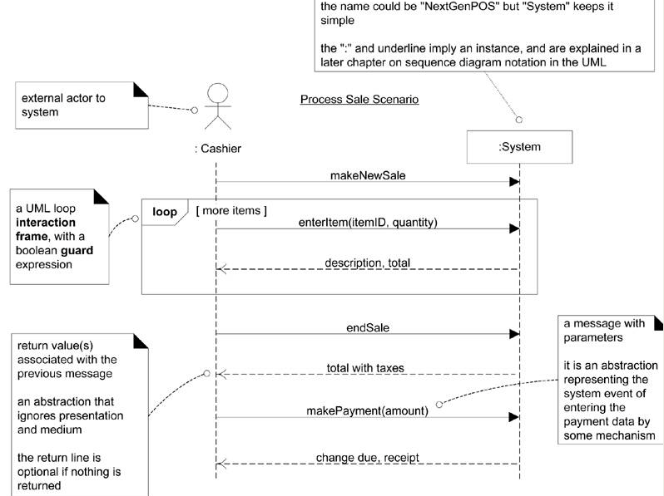

Slide 27
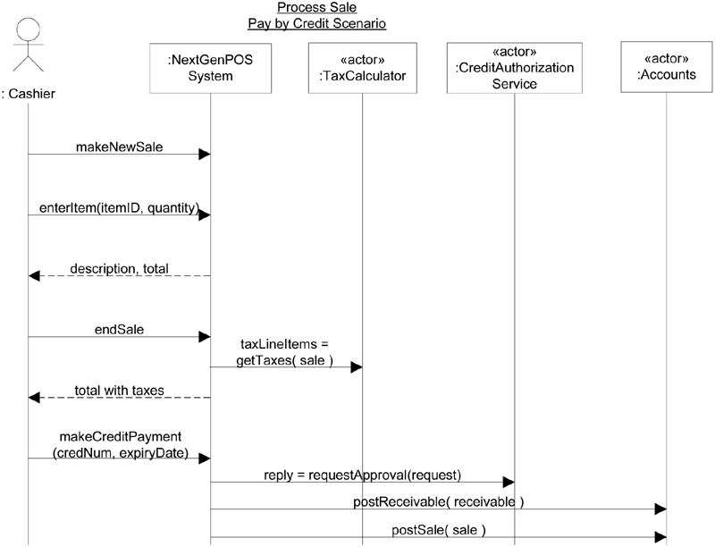
Cashier
System
makeNewSale()
These input system events invoke system operations
enterItem(itemID, quantity)
Description, total
The system event makeNewSale invoke a system operation called makeNewSale and so on
[More items]
endSale()
Total with taxes
makePayment(amount)
Similar to OOP when we say the message to invoke the method (handling operation)
Change due, receipt
System operations handle input system events.
Notes:
In sequence diagrams, if there is a variable assigned before an operation name, it typically indicates that the result of that operation (or message) is being stored in the variable. This notation is used to show that the outcome of a message or method call is captured and used later in the sequence.
Variable Assignment Syntax:
The notation usually looks like this: variable = operationName().
It means that the result of the operation (operationName()) is being stored in the specified variable (variable).
Purpose of Using Variable Assignment:
Capturing Output: To capture the output or return value of a method call or operation for later use within the sequence.

Slide 28
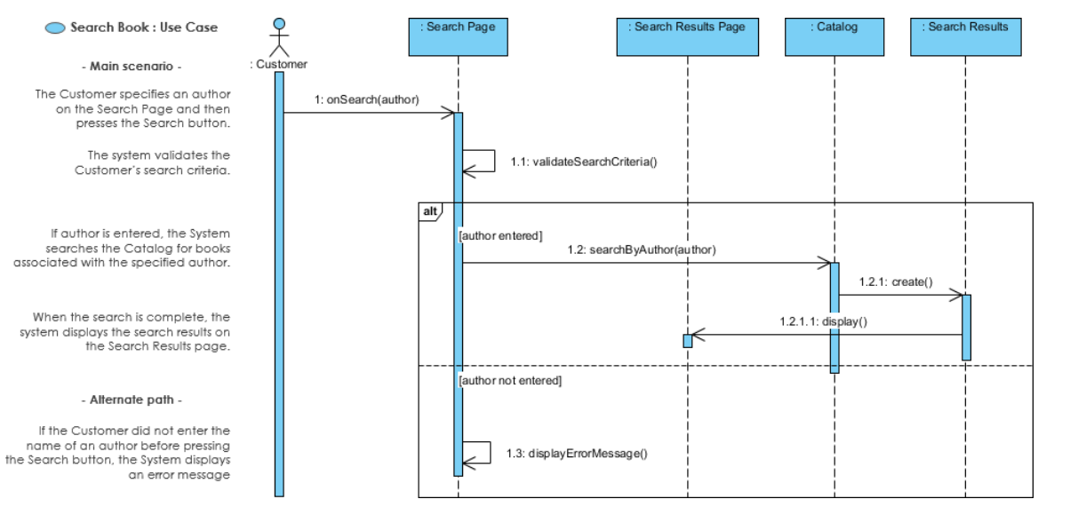

Slide 29
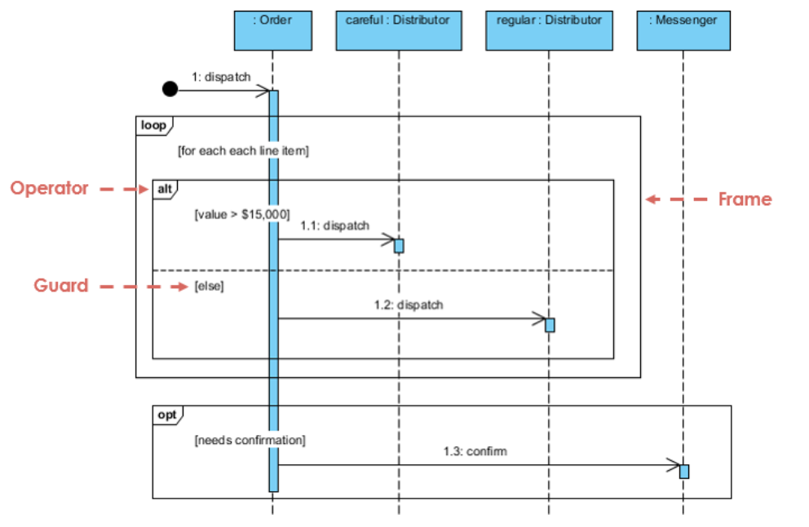

Slide 30
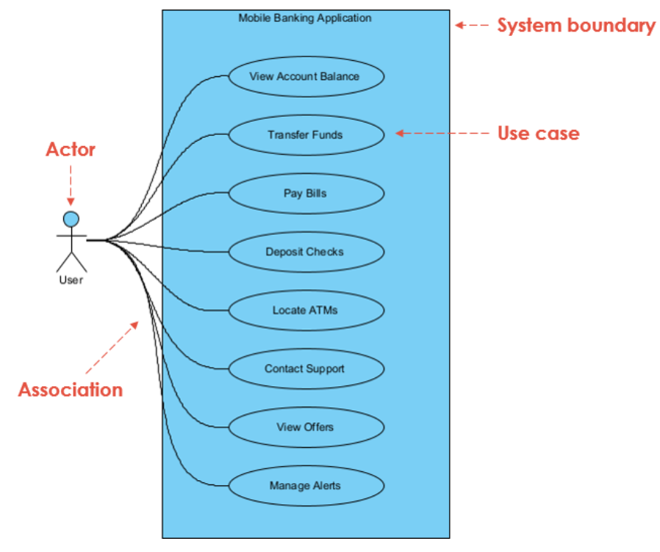

Slide 31
Use case description for the “Transfer Funds”
Use Case Name: Transfer Funds Actors: User Summary: This use case allows the user to transfer funds between their own accounts or to other accounts. Preconditions:
The user must be logged in to the mobile banking application.
The user must have at least one account set up in the application.
Basic Flow of Events:
The user selects the “Transfer Funds” option from the main menu of the mobile banking application.
The application presents the user with a list of their accounts.
The user selects the account they want to transfer funds from.
The application presents the user with a form to fill out with the recipient’s account information, including the account number and the name of the recipient.
The user provides the account information and enters the amount they want to transfer.
The application validates the recipient’s account information and the available balance in the user’s account from the bank.
If the validation is successful:
The application deducts the transfer amount from the user’s account and adds it to the recipient’s account.
The application displays a confirmation message to the user with the details of the transfer.
If validation fails:
The application displays an error message to the user specifying the reason for the failure (e.g., insufficient balance, invalid recipient account information).

Slide 32
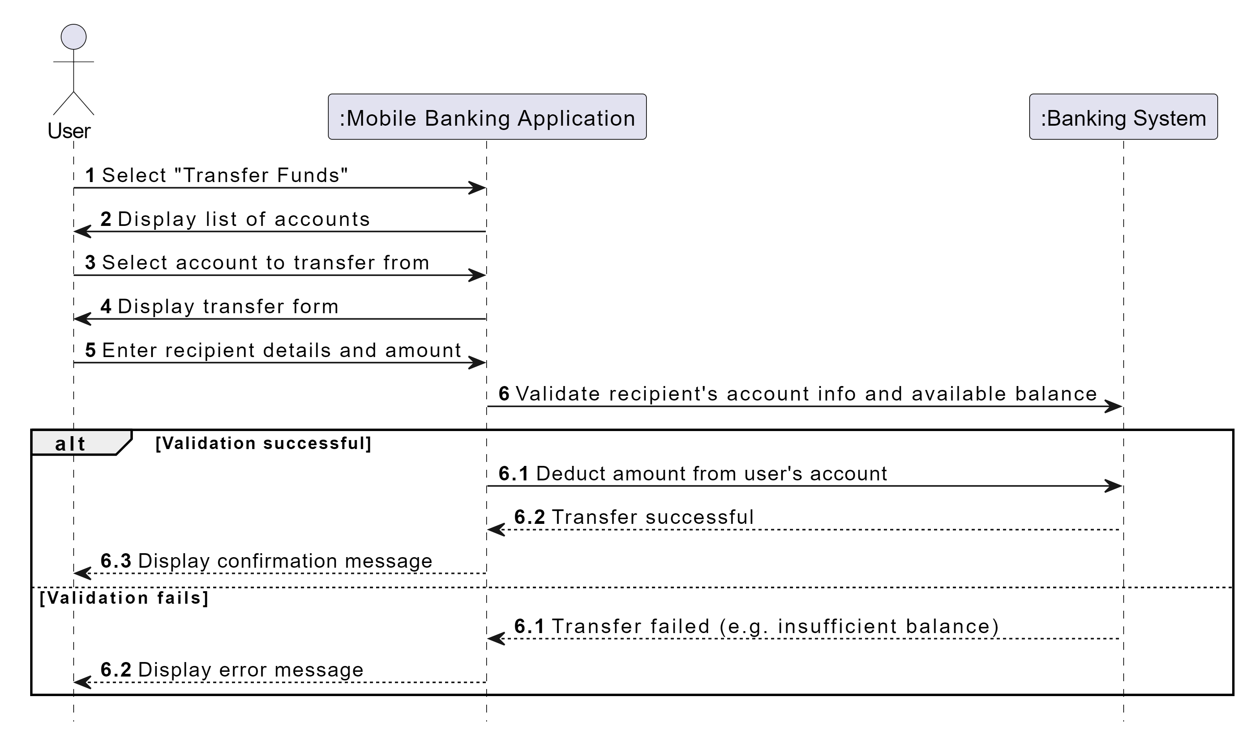

Slide 33
References
Larman, Craig. Applying UML and patterns: an introduction to object oriented analysis and design and interative development. Pearson Education India, 2012.
Object-Oriented Analysis and Design with Applications, Grady Booch et al., 3rd Edition, Pearson, 2007.
Timothy C. Lethbridge, Robert Laganaiere, Object-Oriented Software Engineering (2nd Edition), McGraw Hill, 2005
Object-Oriented Modeling and Design with UML, Michael R. Blaha and James R. Rumbaugh, 2nd Edition, Pearson, 2005.

